Slide 1

Caesar Cipher
SYNOPSIS
Submitted in partial fulfillment of the requirement of the degree of
BACHELOR OF TECHNOLOGY
In
Computer Science and Engineering
by
Shubh Gaur (1/18/FET/BCS/185)
Harsh Vardhan (19/FET/CS(L)/003)
Shivam Sharma (1/18/FET/BCS/207)
Madhusudhan Mishra (1/18/FET/BCS/199)
Under the supervision of
Ms. Pronika Chawla
Associate Professor
Faculty of Engineering & Technology
Manav Rachna International Institute of Research and Studies
SECTOR-43, SURAJKUND –DELHI ROAD, FARIDABAD – 121001

Slide 2
Contents
Introduction
Problem Statements
Objectives
Hardware and software requirements
Literature Review
Designing Part
Implementation
Expected Outcome Of project /Result
Conclusion
Future Scope
References

Slide 3
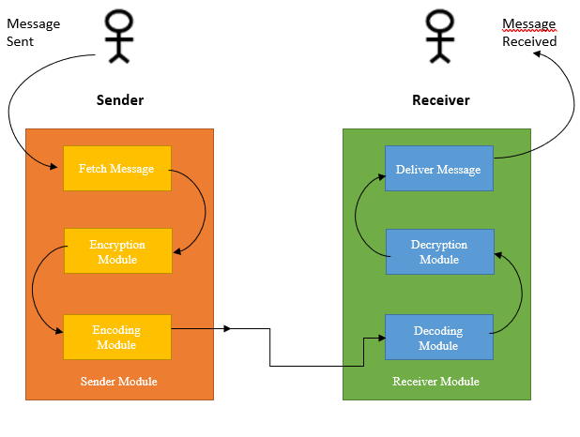
Introduction
In our project, we have integrated three encryption algorithms together to generate a hybrid cipher which will not be easy to crack because not only we are integrating the three algorithms but also modifying the working of two encryption algorithms used and using the third encryption as it is in our hybrid cipher.

Slide 4
Problem Statement
Using the old traditional Caesar cipher technique is obsolete as one can easily decipher it using brute-forcing, as there are not a wide range of keys available. At any time, key will be in the range of 0-25 only and the same key will be used to shift each character of the plain text.
One of the limitations of Playfair technique is that J and I are considered equal, there is no way to find out during decryption whether the character that has just been decrypted was J or I which leads to inconsistency.
Second limitation of Playfair is that If X is present side by side in the text that we want to encrypt, then we won’t be able to pair it with another X as it will generate the same result and will also lead to the violation of the rule that no two characters can be together.

Slide 5
Objectives
One of the objective of our project is to come up with a solution to overcome the limitations of the three encryption techniques used in the project and modify their working to enforce them.
The main purpose of our project is to protect digital data confidentiality using three layered hybrid encryption implemented by combining three of the popular techniques namely Caesar cipher, Vigenere cipher and Playfair cipher.

Slide 6
Hardware and software requirements
PC/Laptop
Software: Visual Studio Code/ Jupyter-Notebook/Sublime/Pycharm.
All modern operating systems viz. Windows, Linux, MacOS, RedHat CentOS etc.
2GB RAM

Slide 7
Literature Review
Cryptology, which is the investigation of cryptosystems, includes two disciplines: cryptography and cryptanalysis. Cryptography is worried about the plan of cryptosystems, while cryptanalysis concentrates on the breaking of cryptosystems (Henk and Van, 2000).The part of science which manages secure correspondence on presence of gatecrashers is cryptography(Henk& Van, 2000).It is one of the significant spaces of study in data security. Others incorporate, yet not restricted to, steganography and organization security. Cryptography is characterized as the science and specialty of encoding and unscrambling information utilizing some extraordinary measures. Encryption is the strategy for masking plaintext so as to conceal its substance while unscrambling (which is something contrary to encryption) is unhiding the substance by changing the ciphertext to its unique plaintext (Rhodes-Ousley, 2013). Cryptanalysis, then again, is the part of science which manages breaking the codes and removing the profound significance, while the entire framework which involves both cryptography and cryptanalysis is called cryptosystem (Paar& Pelzl, 2010).

Slide 8
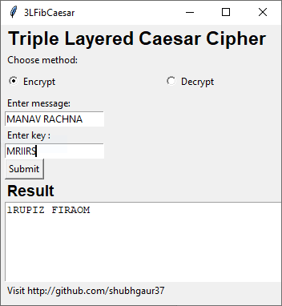
UI Design Encryption

Slide 9
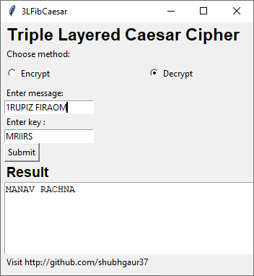
UI Design Decryption

Slide 10
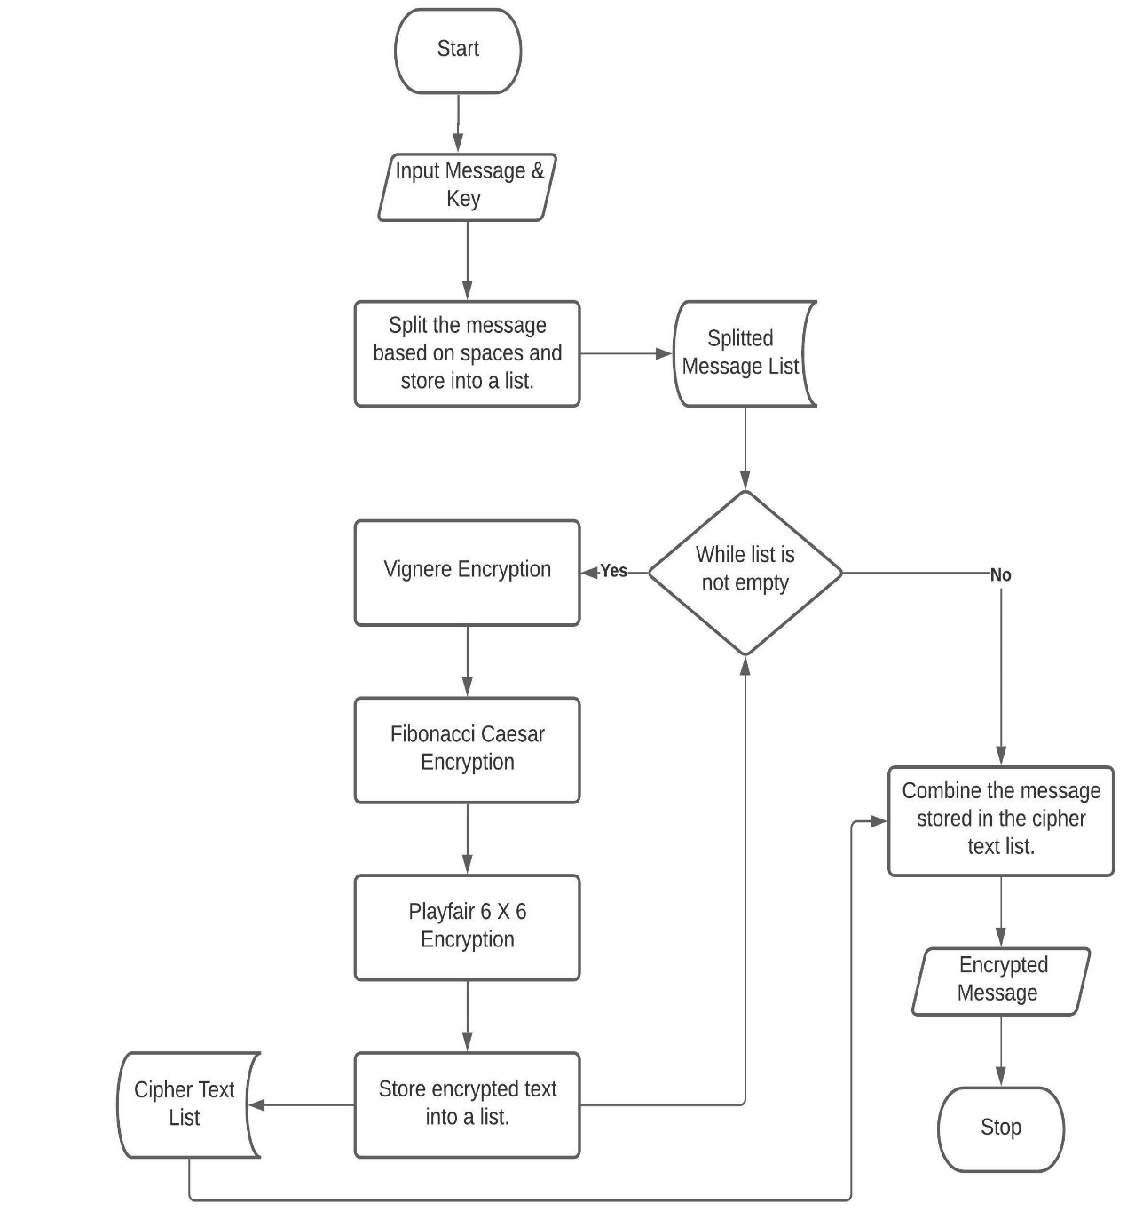
Implementation Encryption

Slide 11
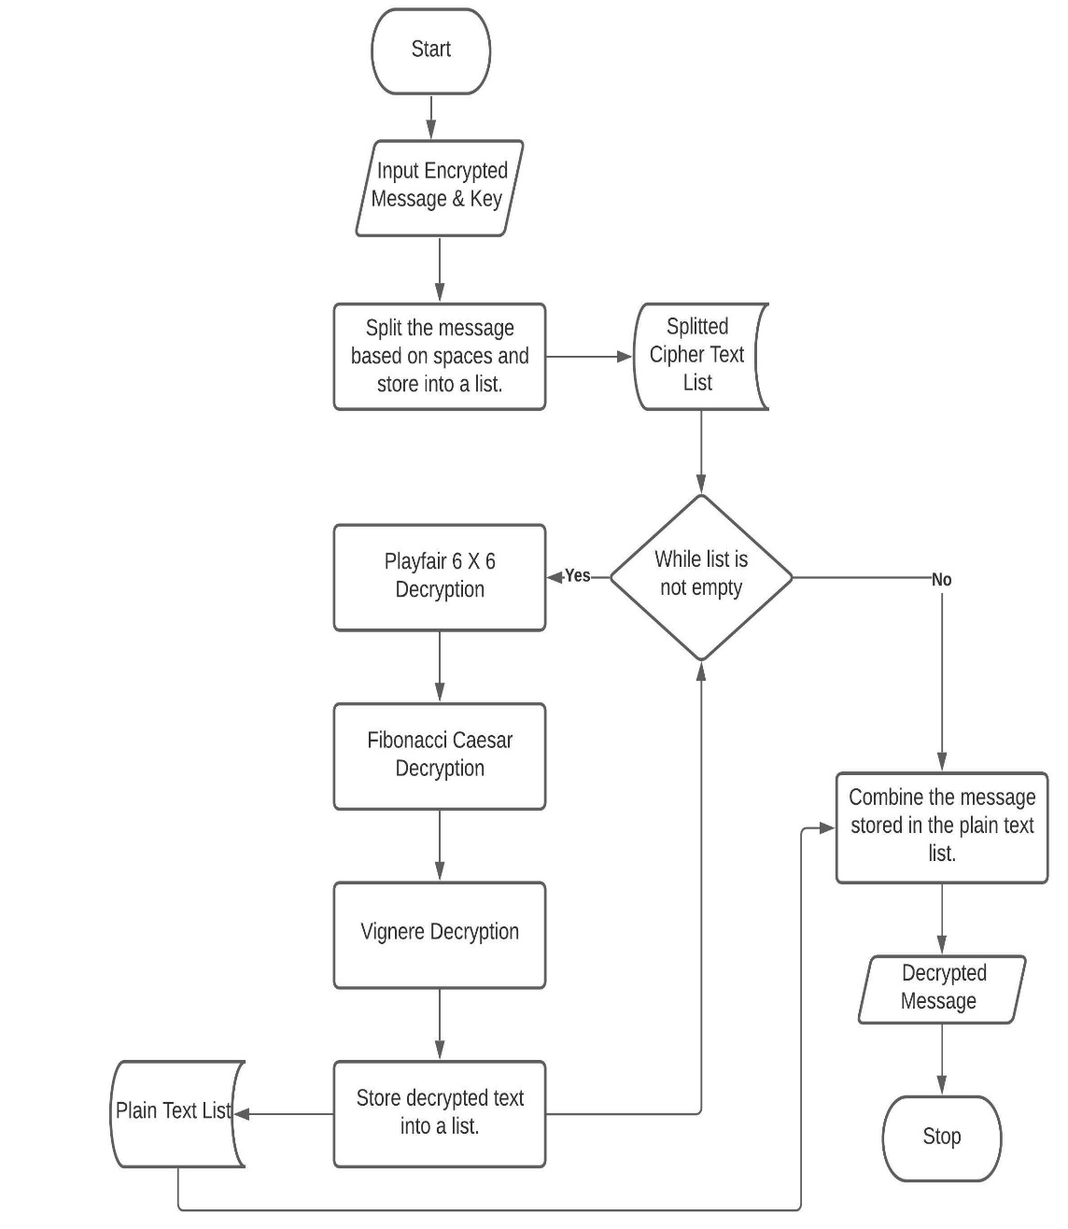
Implementation Decryption

Slide 12
Expected Outcome Of project /Result
A simple cryptography application written on the three commonly used ciphers namely Caesar cipher, Vigenère cipher, and Playfair cipher with slight modifications in the original algorithm to overcome the limitations of these techniques and make them harder to crack.

Slide 13
Conclusion
Our project started from the Caesar Cipher and ended up becoming a triple layered encryption algorithm with its basic architecture being the Caesar cipher, the Playfair cipher and the Vigenère cipher. We aimed to create an encryption algorithm that would be hybrid and better suited to providing confidentiality, integrity and authenticity of the data that the user wants to encrypt.
The algorithm we created is extremely difficult to crack, albeit near impossible because of the number of permutation and combinations one would have to try to hope to crack the algorithm and get to the critical information.
Our algorithm is new and absolutely original, no one has been able to or tried to cover up the limitations of the existing encryption algorithms while turning them into a unique hybrid like this one.
This tool hides the data in transit so that it cannot be intercepted by an attacker and in case if it is intercepted then he won’t be able to make any sense out of it as the data is encrypted.

Slide 14
Future Scope
Our project aims to help people by giving them the opportunity to step into the inconceivable huge field of cryptography. This project shall be about giving people a new option to encrypt their data and store it securely.
The project shall have a huge scope of improvement, be it related to adding more cryptographic algorithms in the already existing hybrid algorithm or improvement of the UI and frontend.
It would prove to be most useful to teachers, professors, students and cybersecurity enthusiasts who aim to teach and learn the ways of cryptographic algorithms and the processes involved in it. The field of cryptography should be filled with people who are well informed and aim to improve the currently existing architectures and procedures.
Thus, our project’s idea is simple but an efficient way to give back to the community with a lot of scope of improvement in the sustainable future.

Slide 15
References
Champakamala B.S, Padmini K and Radhika D.K 2014 Least Significant Bit Algorithm for Steganography Int. J. of Advance Computer Technology 3 4
Emam, Marwa M, Aly Abdelmgeid A and Omara Fatma A 2016 An Improved Image Steganography Method Based on LSB Technique with Random Pixel Selection Int.l J. of Advanced Computer Science and Applications 7 17-22
Inan, Y. (2019). Analyzing the Classic Caesar Method Cryptography. 4th International Conference on Computational Mathematics and Engineering Sciences(pp. 213-220)
Monika,A.,& Pradeep,M. (2012). A Comparative Survey on Symmetric Key Encryption Techniques.International Journal on Computer Science and Engineering (IJCSE), 877-882.
Senthil, K.,et al. (2013). A modern avatar of Julius Caesar and Vigenere cipher. IEEE International Conference.Computational Intelligence and Computing Research (ICCIC)
Verma, O.P et al. (2011). Performance Analysis Of Data Encryption Algorithms. IEEE.Delhi Technological University India
Atish,J.,et al.(2015).Enhancing the Security of Caesar Cipher Substitution Method using a Randomized Approach for more Secure Communication. International Journal of Computer Applications, 129(13),6-11.DOI: 10.5120/ijca201590706
Sahai A, Waters B (2005) Fuzzy identity-based encryption. In: Annual international conference on the theory and applications of cryptographic techniques. Springer, Berlin, Heidelberg

Slide 16
References Continued..
Han F et al (2014) A general transformation from KP-ABE to searchable encryption. Future Gener Comput Syst 30:107–115
Rachmawati Dian and Candra Ade 2015 Implementation of the combination of Caesar Cipher and Affine Cipher for text data security Informatics Research and Education Journal (JEPIN) 1
Ariyus D. 2008 Introduction to Cryptography: Theory, analysis and implementation (Yogyakarta: Andi)
Basuki, Paranita and Hidayat 2016 Design of Layered Cryptography Applications Using Caesar Algorithms, Transpositions, Vigenere and Block Cipers Based on Mobile National Seminar on Information and Multimedia Technology. STMIK AMIKOM (Yogyakarta,)
Bellare, M., Desai, A., Jokipii, E., Rogaway, P.: A concrete security treatment of symmetric encryption: analysis of the DES modes of operation. In: Proceedings of the 38th Symposium on Foundations of Computer Science. IEEE (1997)
K. Senthil, K. Prasanthi and R. Rajaram, "A modern avatar of Julius Caesar and Vigenere cipher", Computational Intelligence and Computing Research (ICCIC) 2013 IEEE International Conference, pp. 1-3, 2013.

Slide 17

Thank You.

